Slide 1
Addressing Modes
The way an instruction accesses its operands is called its Addressing modes.
We can classify the addressing modes of 8086 into four groups:
Immediate addressing
Register addressing
Memory addressing
I/O port addressing

Slide 2
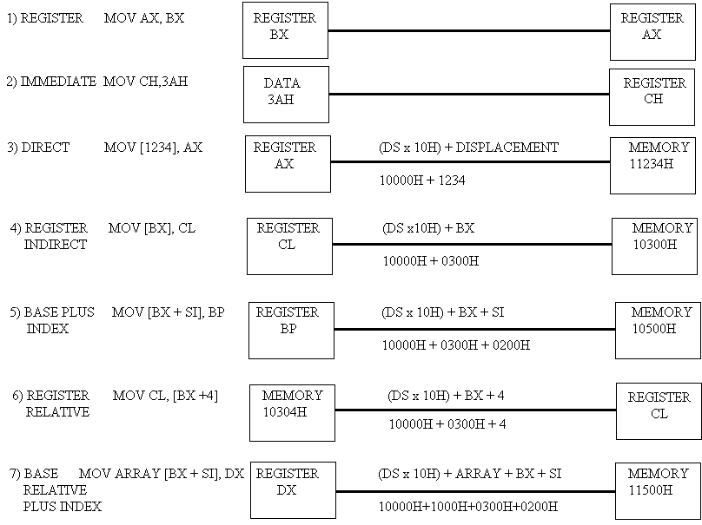
8086 Addressing Modes

Slide 3
Addressing Modes of 80386
Register Addressing Modes
The 80386 processors provide 32 bit registers, eax, ebx, ecx, edx, esi, edi, ebp, and esp.
Usage of these registers as operands to several 80386 instructions.
80386 Memory Addressing Modes
The 8086 only allowed you to use bx or bp as base registers and si or di as index registers, the 80386 lets you use almost any general purpose 32 bit register as a base or index register.

Slide 4
Register Indirect Addressing Modes
On the 80386 any general purpose 32 bit register can be specified when using the register indirect addressing mode.
[eax], [ebx], [ecx], [edx], [esi], and [edi] all provide offsets, by default, into the data segment. The [ebp] and [esp] addressing modes use the stack segment by default.
mov al, [eax]
mov al, [ebx]
mov al, [ecx]
mov al, [edx]
mov al, [esi]
mov al, [edi]
mov al, [ebp] ;Uses SS by default.
mov al, [esp] ;Uses SS by default.

Slide 5
80386 Indexed, Base/Indexed, and Base/Indexed/Disp Addressing Modes
The indexed addressing modes (register indirect plus a displacement) allow you to mix a 32 bit register with a constant.
mov al, disp[eax] ;Indexed addressing modes
mov al, [ebx+disp]]
mov al, disp[ebp] ;Uses SS by default
mov al, disp[esp] ;Uses SS by default.
The base/indexed addressing modes let you pair up two 32 bit registers.
mov al, [eax][ebx] ;Base+indexed addressing
The base/indexed/displacement addressing modes let you combine a constant and two registers to form the effective address.
mov al, disp[eax][ebx] ;Base+indexed+displacement addressing

Slide 6
80386 Scaled Indexed Addressing Modes
These modes let you multiply the index register in the addressing mode by one, two, four, or eight.
The general syntax for these addressing modes is
disp[index*n]
[base][index*n]

Slide 7
The 80386 computes the effective address by adding disp, base, and index*n together.
For example, if ebx contains 1000h and esi contains 4, then
mov al,8[ebx][esi*4] ;Loads AL from location 1018h
mov al,1000h[ebx][ebx*2] ;Loads AL from location 4000h
mov al,1000h[esi*8] ;Loads AL from location 1020h

Slide 8
Exceptions and Interrupts
There are two sources for external interrupts
and two sources for exceptions:
Interrupts
Maskable interrupts, which are signalled via the INTR pin.
Non maskable interrupts, which are signalled via the NMI (Non-Maskable Interrupt) pin.
Exceptions
Processor detected. These are further classified as faults, traps, and aborts.
Programmed. The instructions INTO, INT 3, INT n, and BOUND can trigger exceptions. These instructions are often called "software interrupts", but the processor handles them as exceptions.

Slide 9
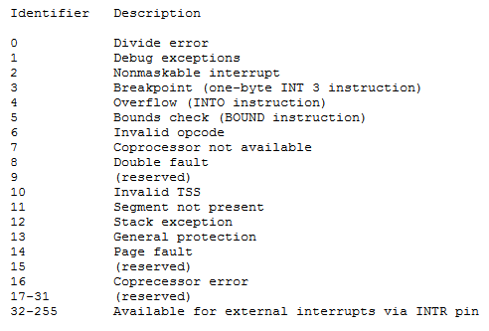
Interrupts of 80386

